Slide 1
Digital Portfolio
STUDENT NAME: CHANDRU.M.P
REGISTER NO AND NMID: 98BC7BD2397C4BC8D9945B4F39D565B8
DEPARTMENT: BSc AIML
COLLEGE: COLLEGE/ UNIVERSITY:Akshaya college of arts and science/bharathiar university

Slide 2
PROJECT TITLE
INTERACTIVE WEB PORTFOLIO

Slide 3


AGENDA
Problem Statement
Project Overview
End Users
Tools and Technologies
Portfolio design and Layout
Features and Functionality
Results and Screenshots
Conclusion
Github Link
3/21/2024 Annual Review

Slide 4

PROBLEM STATEMENT
Resumes are useful but they don’t fully show a person’s skills. They are static and limited. In today’s world, we need something more dynamic. A digital portfolio website gives me space to display my projects, skills, and contact information in an interactive way.

Slide 5

PROJECT OVERVIEW
This project is a single-page portfolio website built with HTML, CSS, and JavaScript.
It works on desktop and mobile, and is designed to look clean and user-friendly.
The portfolio highlights my background, skills, and projects so that recruiters or collaborators can easily know my abilities.

Slide 6

WHO ARE THE END USERS?
Recruiters/Companies: To quickly see my skills and projects.
Professors & Classmates: To check my academic work.
Hackathon/Project Teams: To understand my strengths for collaboration.
Myself: To track my learning and update my progress.

Slide 7

TOOLS AND TECHNIQUES
Frontend: HTML5, CSS3, JavaScript
Styling: CSS Flexbox & Grid
Icons/UI: Font Awesome
Code Editor: VS Code
Version Control: Git & GitHub

Slide 8
POTFOLIO DESIGN AND LAYOUT
Header & Navbar: Fixed at top with navigation buttons
Home Section: Short introduction about me
About Section: My background and skills
Projects Section: Showcasing 3 main projects (Portfolio, To-Do App, Calculator)
Contact Section: My email and phone for direct reach
Footer: Simple copyright and links
‹#›

Slide 9
FEATURES AND FUNCTIONALITY
Mobile responsive design
Smooth navigation buttons
Hover effects on projects and buttons
Clean and simple interface
Easy to update content later

Slide 10
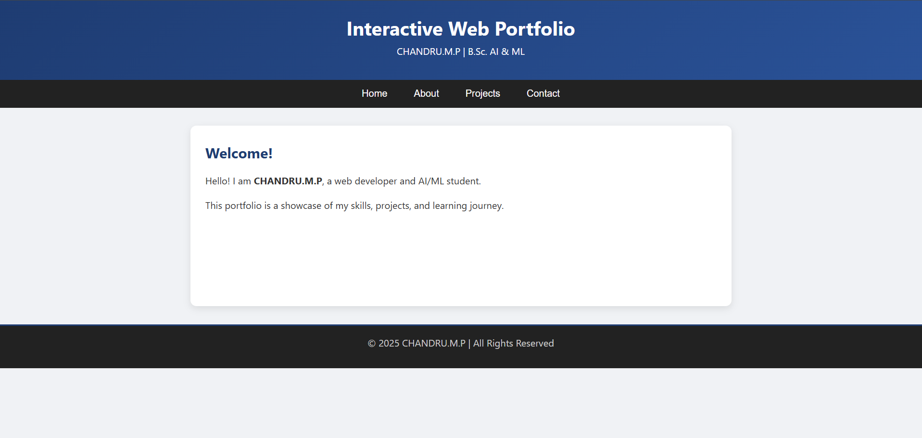

RESULTS AND SCREENSHOTS
3/21/2024 Annual Review
‹#›

Slide 11
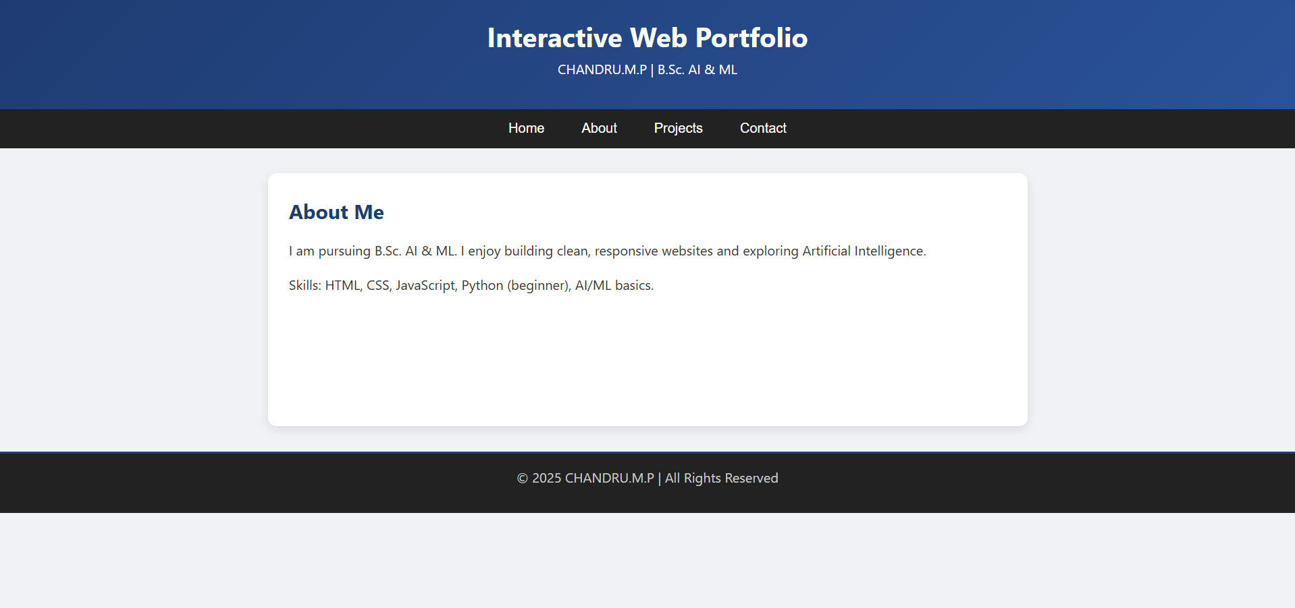
ABOUT ME

Slide 12
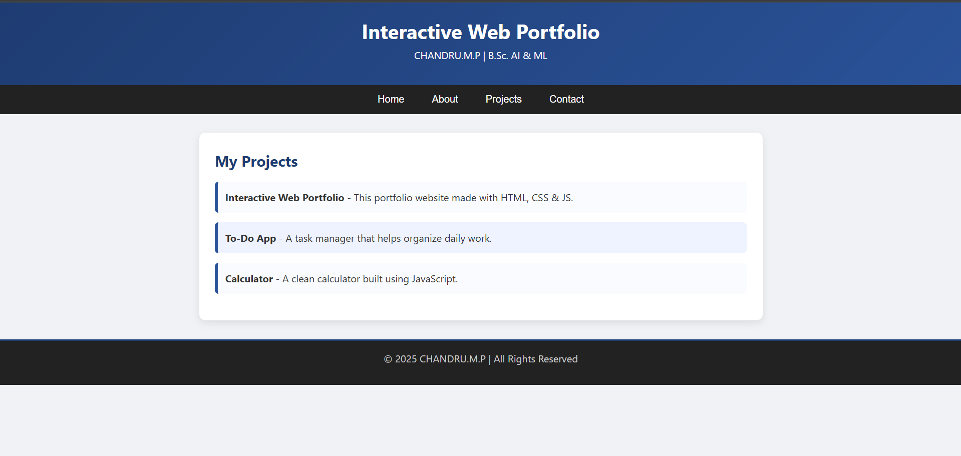
PROJECT:

Slide 13
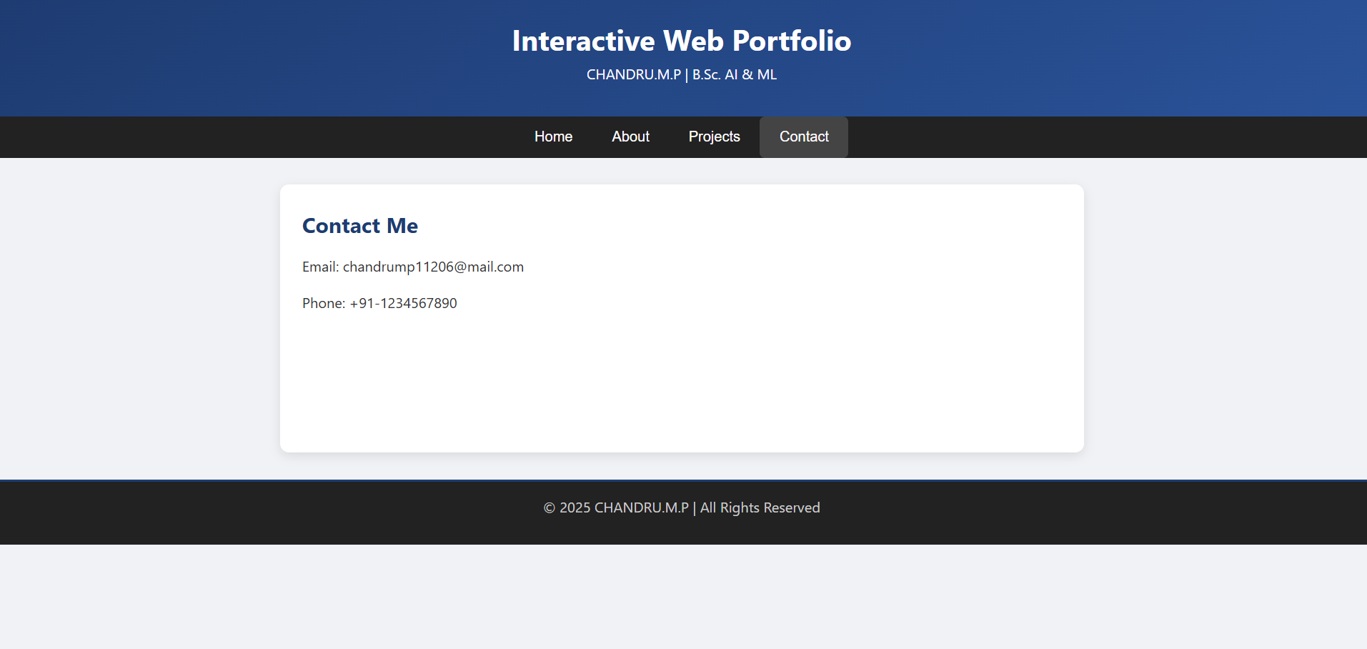
CONTACT:

Slide 14
CONCLUSION
This project helped me practice HTML, CSS, and JavaScript.
It gave me experience in creating a real website with a responsive layout.
More than just an assignment, it’s my personal portfolio that I can keep updating with new skills and projects.
‹#›

